Slide 1
Healthy School Celebrations Toolkit - Training Guide
Extension Service Family and Community Health SNAP-Ed Program, College of Public Health and Human Sciences
Notes:
Welcome all staff members – Introduce self and OSU SNAP-Ed Program – Provide brief description of program involvement at this school / district / county as applicable (direct ed / indirect events / PSE projects)
Describe how excited to be providing today’s HSC training – an initiative that demonstrates how healthy foods and fun activities can come together in a school environment, and still adhere to local Health Department guidelines.
Let’s get started!

Slide 2
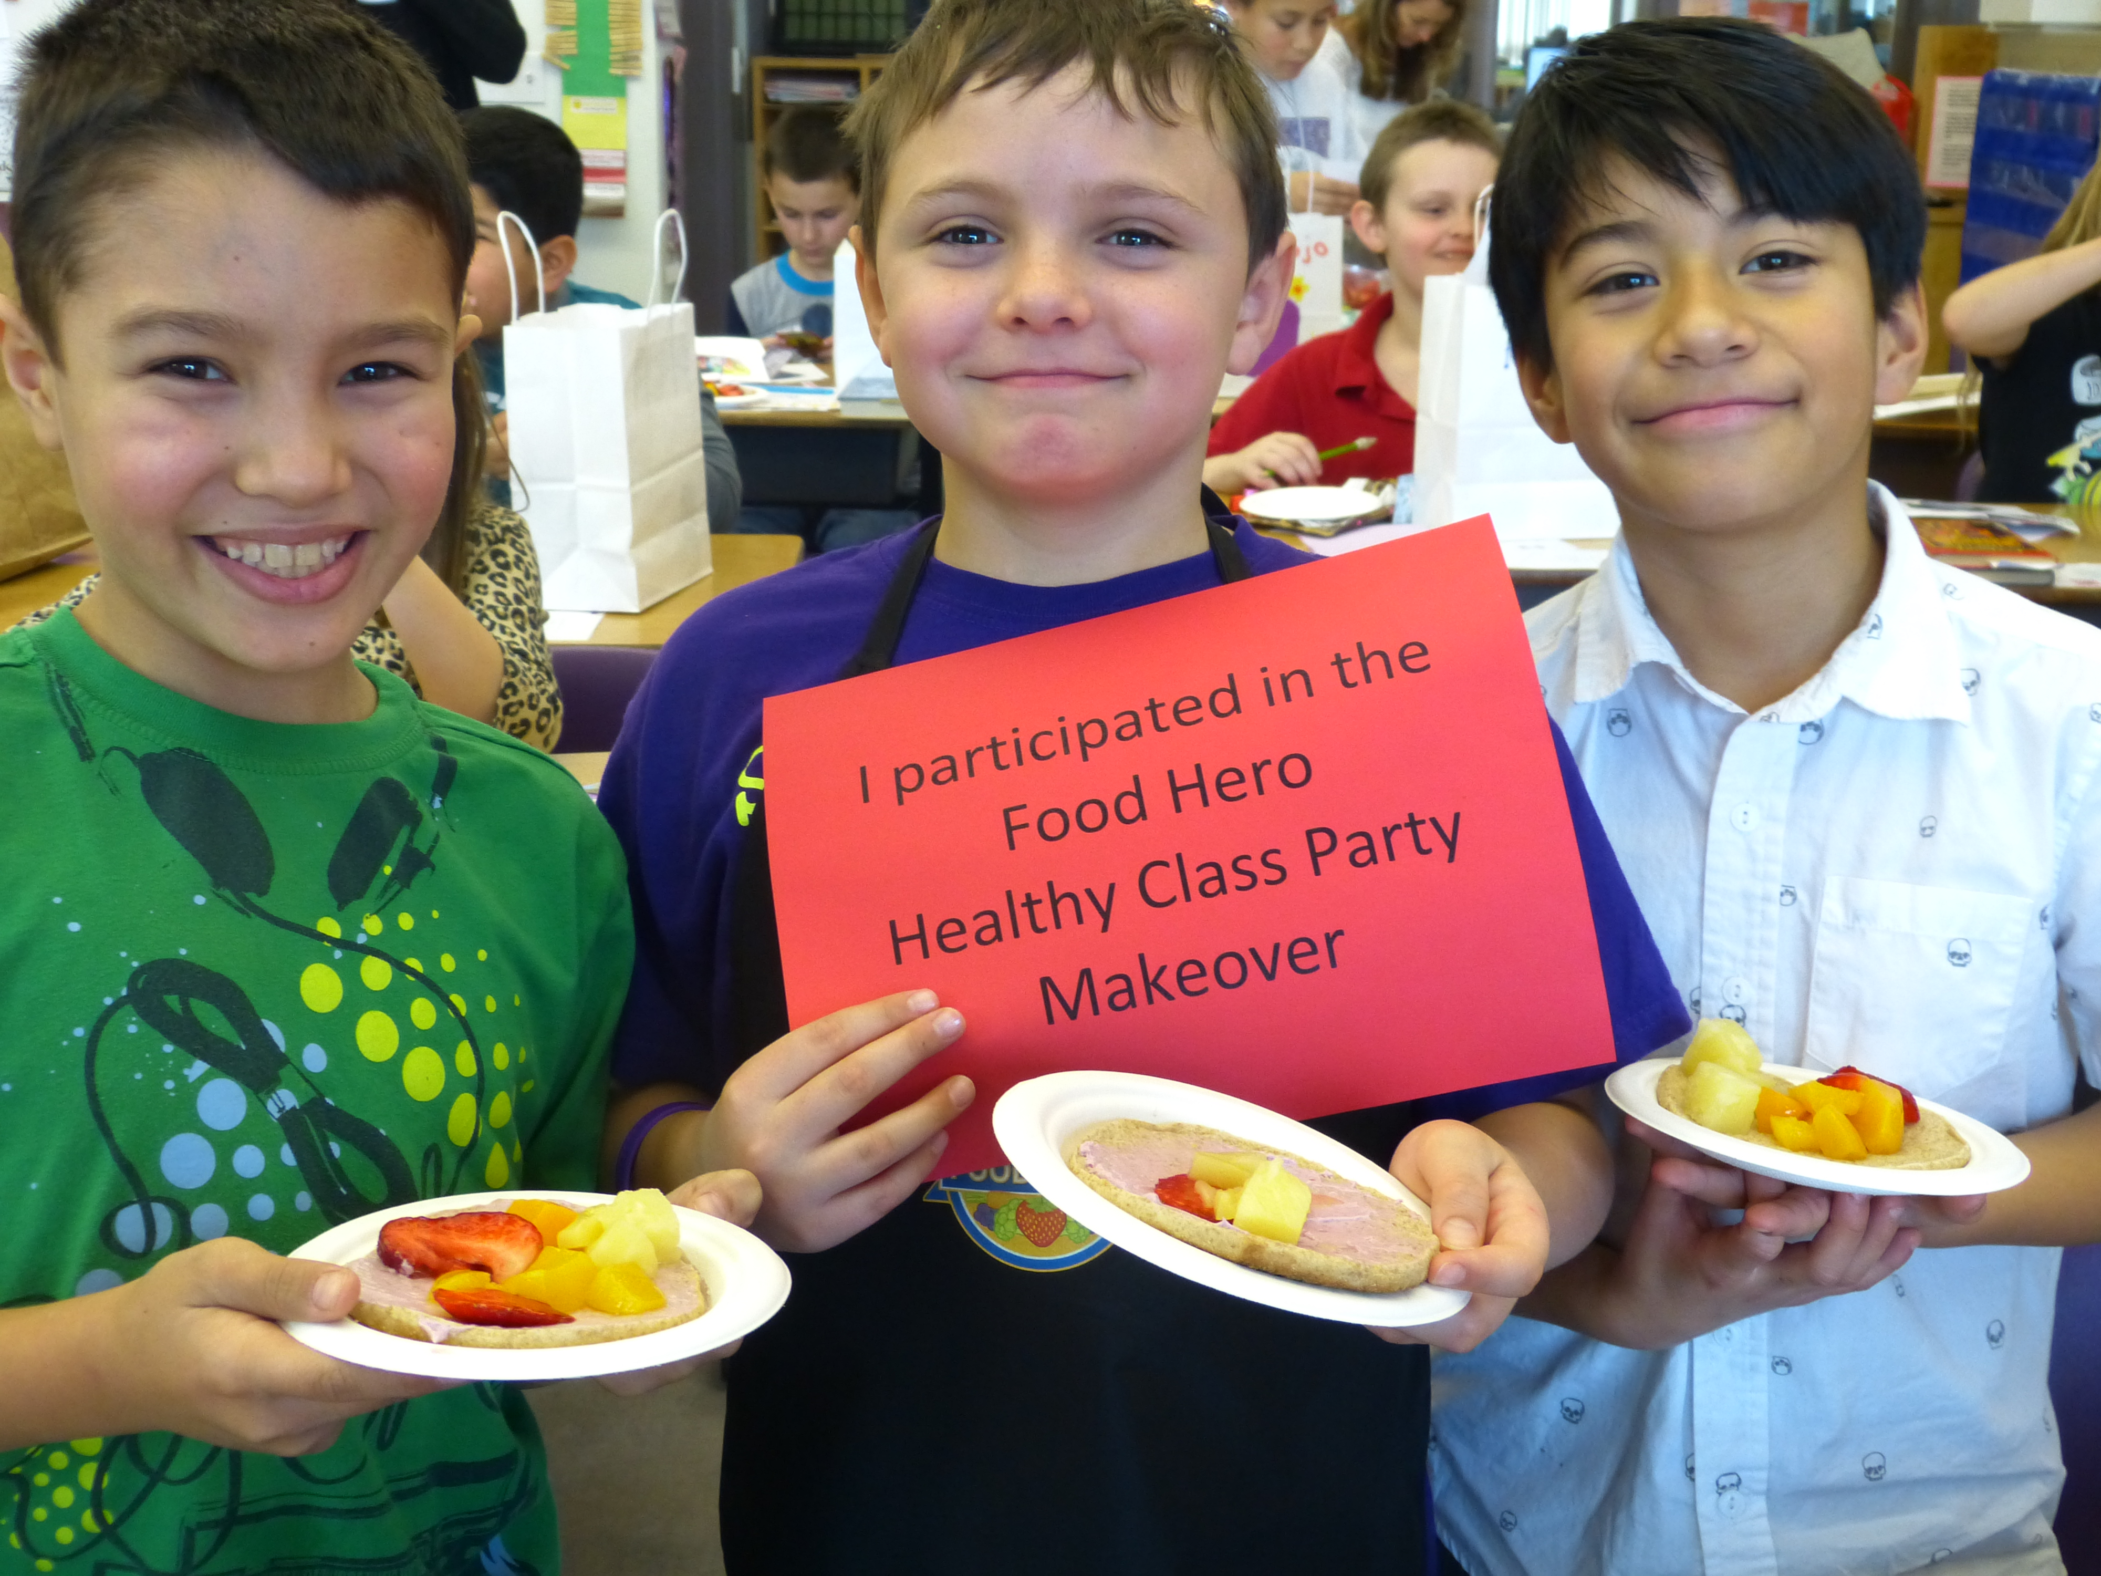
Training Overview
Healthy Celebrations – benefits and strategies
Important guidelines
Toolkit contents
Food Hero recipe demo – tips & strategies
Taking it to the next level
Notes:
Here’s a brief overview of the information we’ll be covering and expanding on in today’s training:
Celebrating the healthy way – why it’s important
Important guidelines – how to adhere to these guidelines and apply food safety practices in a classroom environment.
Healthy Celebrations – exploring the best practices framework, shifting the focus from food to fun, and different strategies to enhance implementation.
I’ll provide a FH recipe preparation demonstration & tasting where we’ll discuss 3 main ways to assemble a recipe in class.
We’ll look at the content of the toolkits you’re receiving and go over the simple reporting component.
Then before wrapping it up, we’ll discuss “taking this to the next level” – how to simplify – save time & money – and savor the fun!

Slide 3
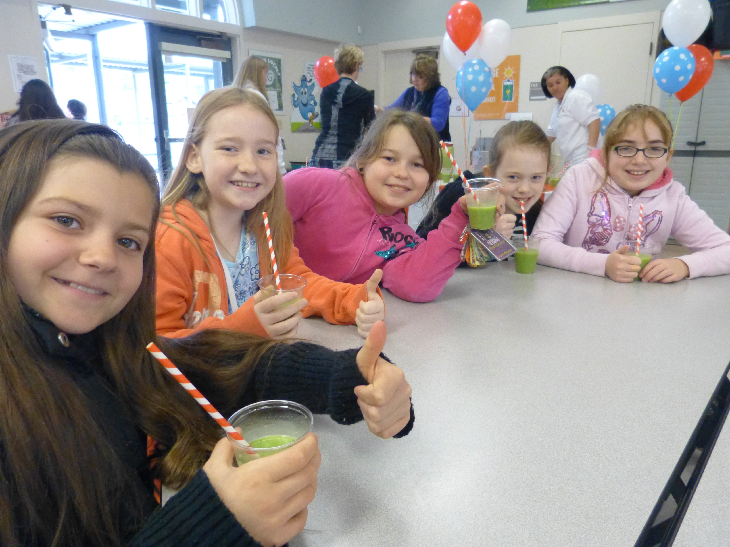
Celebrate the Healthy Way - Providing Healthy Classroom Celebrations:
Helps kids learn better
Provides consistent messages
Promotes a healthy school environment
Creates excitement about healthy eating
Notes:
So why is celebrating the healthy way so important?
Research supports that healthy, active kids are better learners – performing better on tests, more focused in class, behaving better, are absent less, and have higher self-esteem. http://www.actionforhealthykids.org/media-center/reports
Provides consistent messages – Reinforces the healthy choices messaging students are learning in nutrition classes and provides them with the opportunity to apply it when they celebrate. Importantly, it also demonstrates a school’s commitment to promoting healthy behaviors.
Promotes a healthy school environment – In order to positively change eating behaviors, students need to receive consistent, reliable health information and ample opportunity to use it. Healthy celebrations are a great way of doing that.
Creates excitement about nutrition - children are excited about new and different things. By incorporating fun physical activities and healthy snacks, especially ones that the children can be involved in making or serving themselves, celebrating the healthy way and having fun can come together and help establish healthy behaviors as the norm.

Slide 4
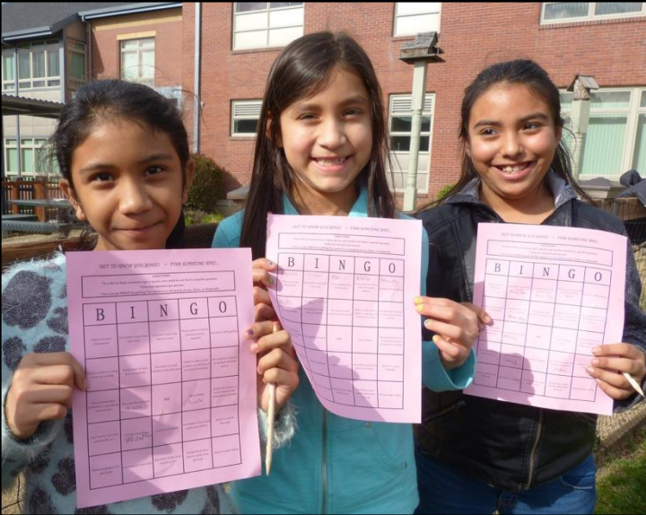
Healthy Celebrations – A Bounty of Strategies
More healthy snacks than unhealthy
A maximum of 2 celebrations a year that include unhealthy foods
Provide only healthy foods at celebrations
Shift focus from food to fun, activity based celebrations
Encourage non-food celebrations
Adopt a Healthy Celebrations Approved Foods List
Create a Healthy Classroom Celebrations Policy
Notes:
There really are a bounty of options and strategies to implementing Healthy School Celebrations. The Best Practices Framework is not a rigid “one size fits all approach”, because the goal with this initiative is to encourage school-wide participation, getting everyone on board with their celebrations, committed to making simple, small changes and promoting healthy habits within the school environment and beyond.
How do we go about this?
Ensure that at your school celebrations healthy snacks outnumber sweets
Reduce the # of celebrations that include sweets to a maximum of 2 per year.
Finally of course, is to aim to provide only nutritious snacks during celebrations.
However, the ultimate goal is to shift the focus of celebrations from being food-centered to activity-centered, where the food is only a sideline component. The Resource Guide provides a list of great activities to incorporate in your celebrations, such as: arts / crafts projects, scavenger hunts, physical activity games.
Ask teachers / participants to share any favorites they’ve used before (make notes)
Comment – with so many great activity options – it’s easy to see how we can encourage and develop non-food celebrations!
The Resource Guide also includes several document templates – designed to save time and simplify the implementation process – refer to & elaborate on Healthy Celebrations Snacks List and Healthy Classroom Celebrations Policy.

Slide 5
Important Guidelines
Rule in some schools: “Only commercially prepared and prepackaged items be offered at classroom events and celebrations.”
This includes store-purchased ingredients that teachers could use to prepare a simple recipe or students could use to assemble a healthy snack in the classroom.
Notes:
Next let’s take a look at how we can have healthy school celebrations that still align with Health Department guidelines & recommendations – in order to do that, as a group we need to understand the guidelines (refer group to copy of local HD Memo included in Resource Guide).
“Only commercially prepared and prepackaged items be offered at classroom events and celebrations” – clarify that this refers to food items purchased at the store. This includes store-purchased ingredients that teachers could use to prepare a simple recipe or students could use to assemble a healthy snack within the classroom.
Example: Name a FH recipe (such as Pumpkin Pudding) and a student assembled healthy snack (such as Yogurt Parfaits) – list ingredients needed, and how purchasing them in the store, and bringing them to the classroom for in-class use, meets first HD guideline discussed.

Slide 6
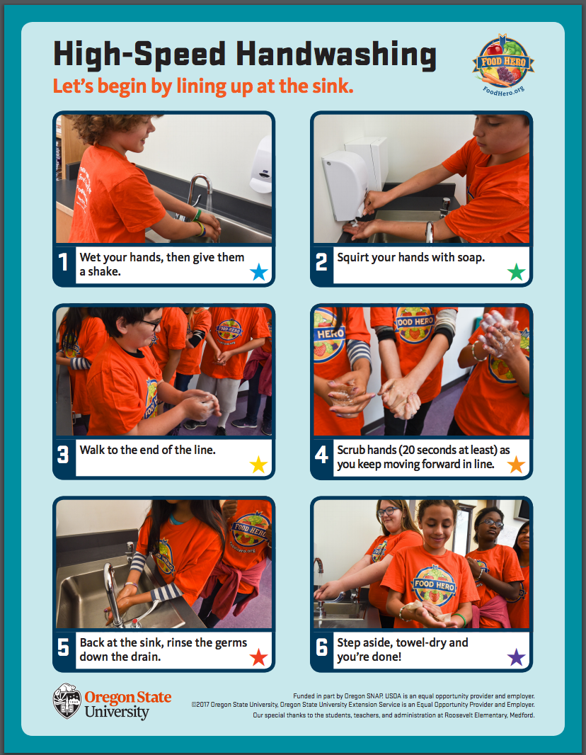
Important Guidelines
Tools that can lower the potential for foodborne illness available at http://foodhero.org/celebrations:
Classroom Handwashing Strategies: high-speed handwashing or sending groups of children to the bathroom.
USDA 10 Tips Nutrition Education Series Be Food Safe – Informative overview highlighting key food safety practices.
Notes:
The second HD recommendation contained in this document refers to food safety and reducing the potential for food borne illness. This is where practicing proper handwashing technique and food safety procedures are key!
Describe the high-speed handwashing method – explain how it enables a full class of students to effectively wash their hands with soap, water, and adequate scrubbing time in about 5 minutes. Emphasize high-speed handwashing as essential part of any classroom celebration involving food.
In the instance of working with upper graders where a student chef team assembles a recipe, proper handwashing is even more essential among this group and making sure that anyone who is ill is excused from food handling / serving.
Refer to USDA 10 Tips Be Food Safe – Review document & elaborate on main points (cleaning of surfaces, utensils, etc.) – highlight that all perishables / leftovers are refrigerated within 2 hours.

Slide 7
Healthy School Celebrations Toolkit Contents
Core Items:
Tablecloth
Solid cutting board
Flexible cutting board
Spatula
Bamboo spoon
Bamboo ladle
Plastic colander
Food storage set
All Packed in a reusable grocery bag
Optional Items:
Dry measuring cup set
Liquid measuring cup
Measuring spoons
Can opener
Mixing bowl
Soap
Sponge
Dish towel
Notes:
Our HSC training has covered: WHY we want to celebrate the healthy way and reinforce healthy choices behaviors, then also shared HOW we can do this in a classroom environment and still adhere to HD guidelines with the food items we use in celebrations by using commercially prepared and prepackaged items coming from the store, as well as following proper food safety practices when preparing or providing snacks in the classroom. Just now we covered the Best Practices Framework exploring various WAYS to improve and expand on the celebration concept, by adding educational components and physical activities to the mix.
The next step is providing each of you with the HSC Toolkit. Contained in each toolkit are the basic food preparation tools needed to prepare many simple assembly-style FH recipes or healthy snacks in class.
The toolkit items: tablecloth, solid cutting board, flexible cutting board, spatula, bamboo spoon, bamboo ladle, plastic colander, food container set, dry measuring cup set, and measuring spoons - are the FH incentives provided through SNAP-Ed funding.
The final six items that help complete the kits: can opener, mixing bowl, liquid measuring cup, soap, sponge, and dish towel – are additional contributions funded by our local CCO All Care.
The reusable grocery bag is a convenient way to keep all of your items together in the classroom.
Resource Guide – review contents – classroom-scaled recipes / Buying Guide, etc.

Slide 8
Food Hero Recipe Demo - Tips & Strategies
Recipe preparation methods:
Teacher-led demo
Student chef team
Student self-serve / assembly line
Accommodating food sensitivities
Adding interactive & educational components to celebrations
For great ideas for healthy, simple, fun snacks – visit www.foodhero.org to connect with the Food Hero Monthly, social media and the Community Kit.
Notes:
Now in order to get a real idea of how this looks and works, I like to provide a demonstration, and let’s face it, at this point I’m pretty sure everyone could use a snack! So if all of you would like to role play with me, I could use 5 student chef assistants to help me assemble this recipe (refer everyone to FH recipe copy in packet being demonstrated).
Lead participants in a high-speed handwashing, followed by each measuring and adding a separate ingredient. Apply some of the educational components mentioned in Resource Guide (for instance, asking participant if the recipe were being doubled, how much would be needed of a particular ingredient, have someone else name food groups in the recipe, etc.) Combine ingredients, serve, taste recipe.
Elaborate on 3 types of recipe preparation methods (listed), discussing benefits and age-appropriate circumstances for each.
Teacher-led demonstration
Student chef team: A student chef team is comprised of the lead students measuring and adding the ingredients of the recipe being assembled in class. Therefore the number of students on the chef team changes each time, directly depending upon the number of ingredients in the recipe and / or additional steps the students are involved in (such as mixing or serving). The teachers frequently have their “self-managers” make up their student chef team (this opportunity is used as a reward to reinforce positive behavior).
Student self-serve/assembly line
Celebrations can be so fun, interactive, and educational when children have the chance to be directly involved (refer to Resource Guide – elaborate on examples).
Food sensitivities – Emphasize awareness of student food sensitivities in the classroom, contacting & clarifying with parents directly when anything listed in student file is vague / confusing. Acknowledge that food sensitivities can be accommodated, and to encourage exploring ingredient substitution options (using soy /almond / rice milk instead of cow milk, lactose-free yogurts, leaving nuts out of recipes, substituting one fruit or fruit juice for another when necessary, etc.)
It’s also good to keep in mind that healthy celebrations can be basic and simple, and still plenty of fun – with simple components kids can get creative with (print and share FH FB page examples – refer to sites for more great ideas).

Slide 9
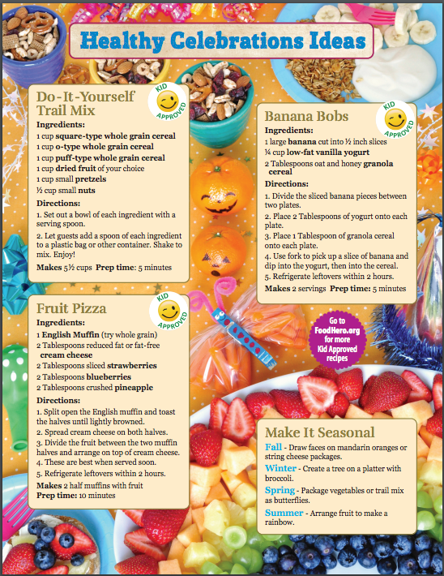
Healthy Celebrations – Food Hero Monthly
Available in English and Spanish at www.foodhero.org/monthly-magazine.
Notes:
Food Hero Special Edition – Featuring Healthy Celebrations
Refer to and highlight it’s tips on: Action Snacks, Celebrating Without Food, Making it Seasonal, & sharing 3 simple, fun assembly-style recipes

Slide 10
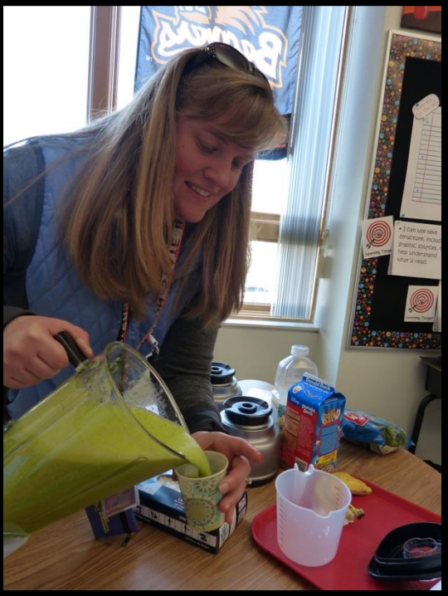
Healthy School Classroom Celebrations - Taking it to the Next Level
Simplifying
Saving Time & Money
Savoring the Fun
Notes:
#1)Simplifying-The Resource Guide includes 3 sample documents that can be used to simplify the process of implementing HSC, save time, and money (refer to each of 3 documents, expand on their applications – if they weren’t covered thoroughly enough earlier)
Healthy Classroom Celebrations Policy – Sample Doc
HC Snacks List – Sample Doc
HSC – Sample Parent Announcement Letter
#2)-Saving Time & Money – Some strategies to help you achieve this through healthy celebrations include:
Coordinate with other teachers / team, agree on a recipe, alternate responsibility of purchasing ingredients, saving with bulk purchases of ingredients & serving supplies.
Remember that with celebrations, when food is being included, the aim is to provide a snack, not a meal. Take advantage of purchasing smaller sized serving supplies (similar to the small tasting cups and plates used in our SNAP-Ed tastings).
Remember Parent Announcement Letter can be sent out prior to a celebration & request contributions of specific ingredients or an extra set of hands for the event.
Using a FH recipe as the food component of a celebration can provide a savings all by itself (share Valentine’s Day Party Makeover story – budgeted $40 for class of 30 and spent $12. doing FH Fruit Pizzas recipe when 2 teachers coordinated to do it together).
#3)-Savoring the fun - Providing healthy celebrations opens up a whole new experience that can include physical activities, educational components, a hands-on healthy food lesson, a nutritional snack, and so much more…be creative & have fun with it…and be proud of it too – because what you’re doing is helping students develop healthy behaviors that can last a lifetime!

Slide 11
Thank You!
Shannon La Fon
Oregon State University
Southern Oregon Research & Extension Center 569 Hanley Road • Central Point, OR 97502 Phone: 541-776-7371 Ext 207 Shannon.LaFon@oregonstate.edu
Notes:
Thank you for your time and support of the Healthy School Celebrations initiative!
Questions? Ideas? Comments?

